Slide 1
RETAIL STORE AUTOMATION
USE CASE,DFD,ERD
23pw14 Maanisha T
23pw15 Madanika SR
23pw16 Naveen Kumar M
23pw17 Nitharshna A
23pw18 Nivethitha D
23pw19 Pranaavraj V

Slide 2
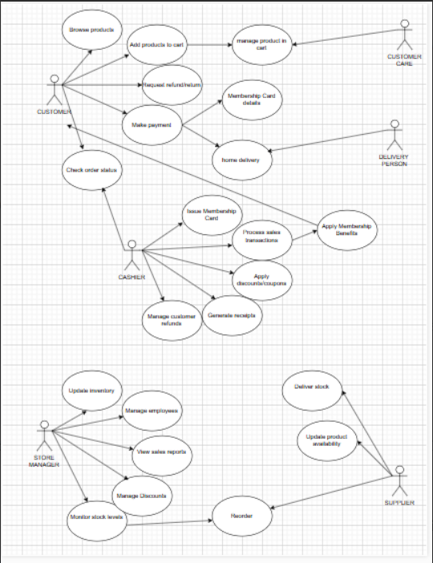
USE CASE DIAGRAM

Slide 3
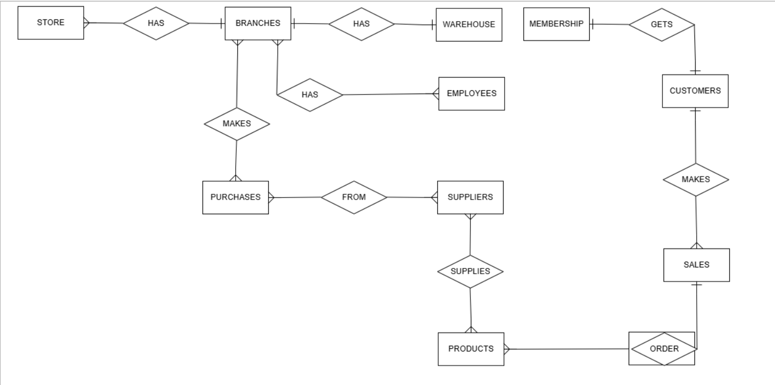
ER Diagram:

Slide 4
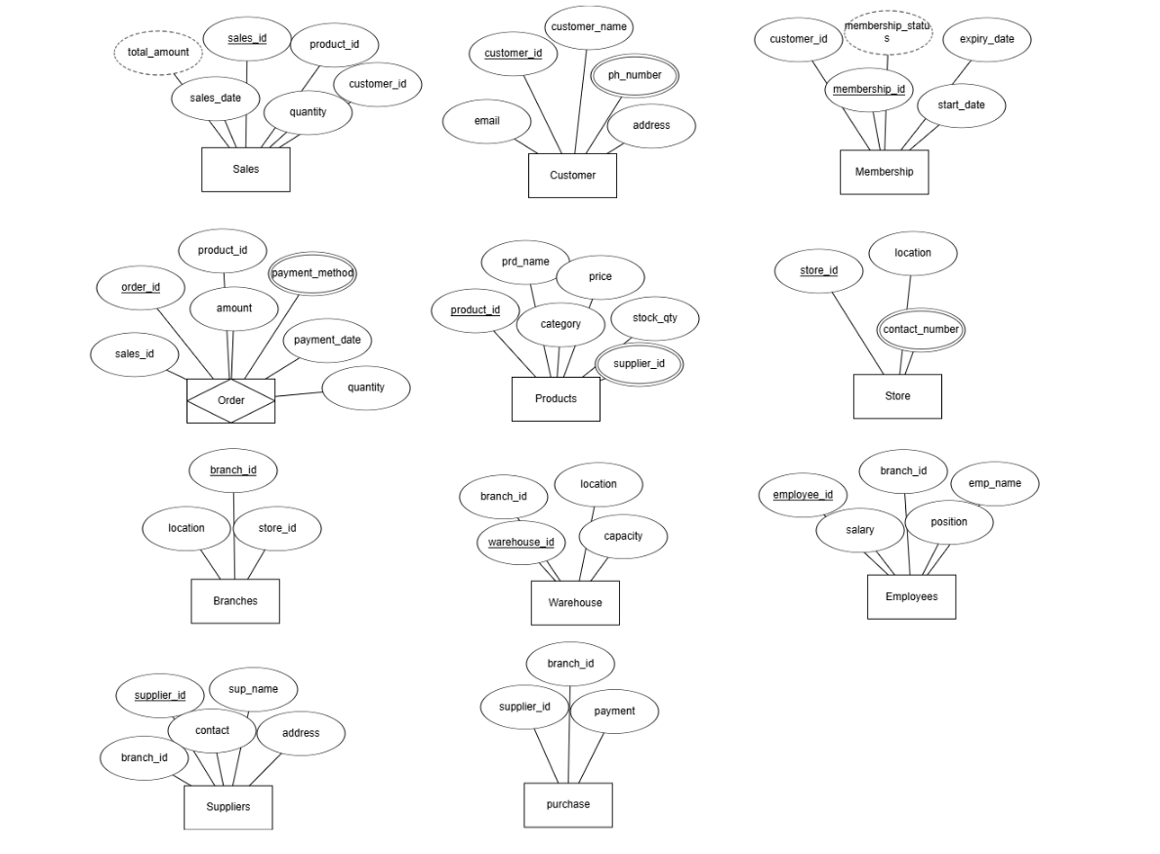
Attributes:

Slide 5
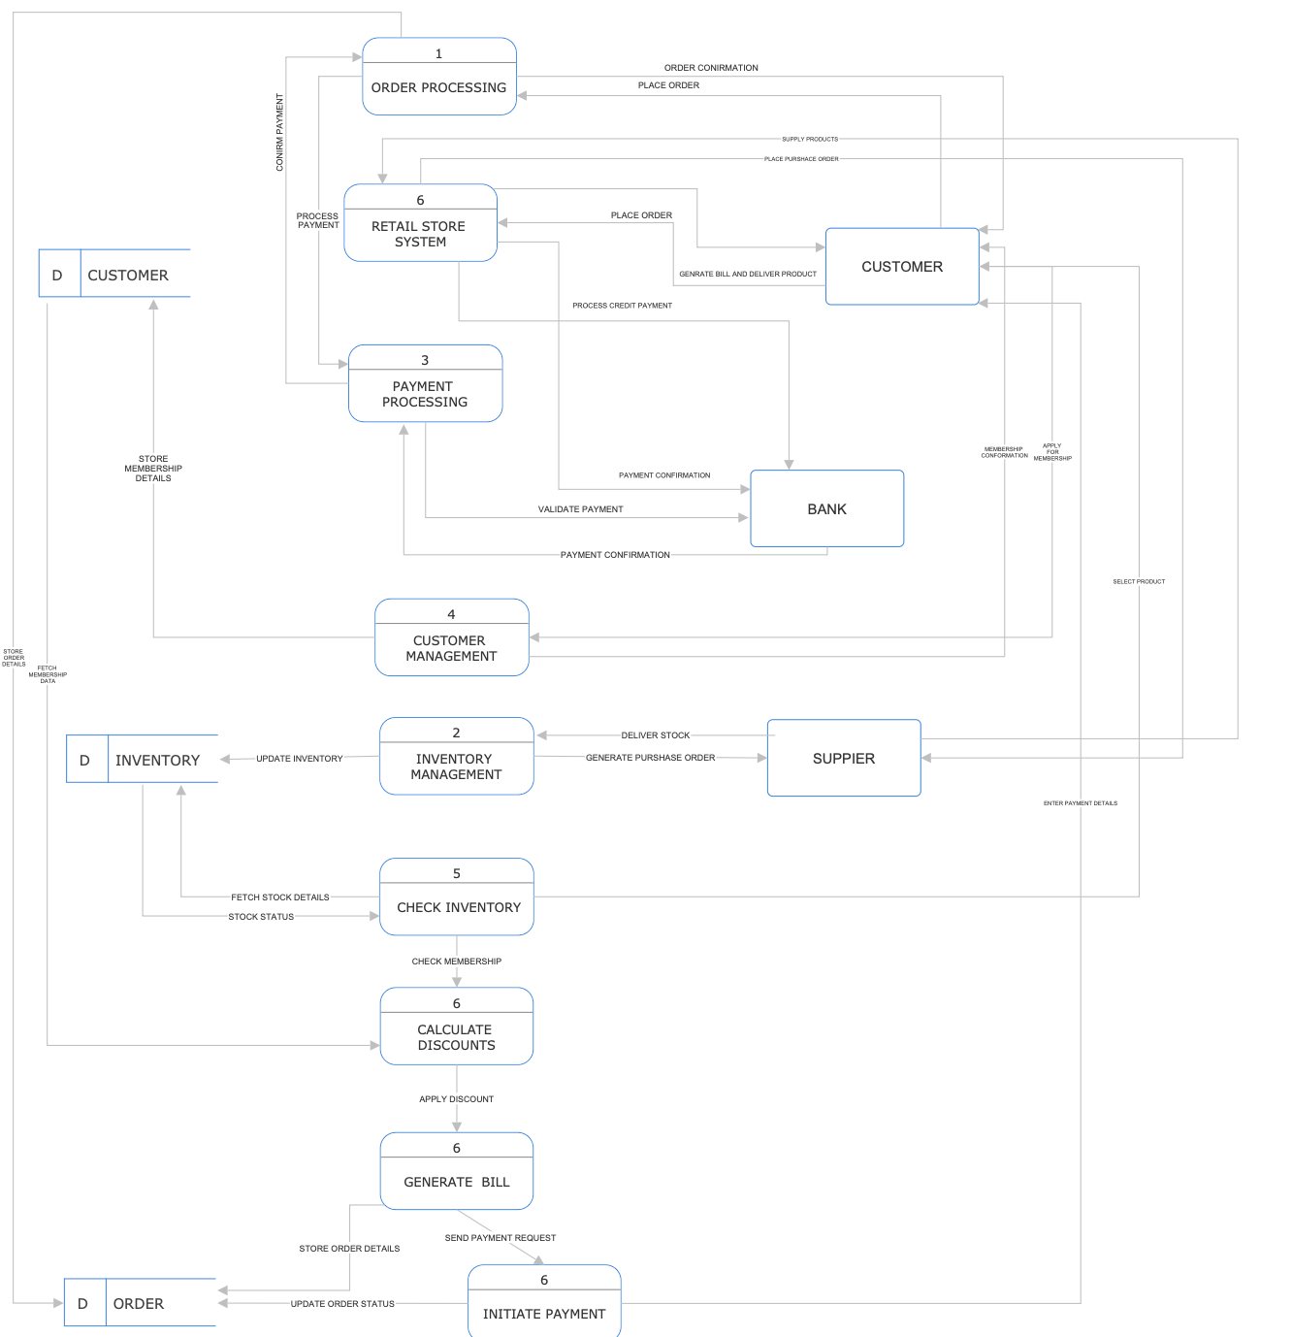
DATA FLOW DIAGRAM:

